Slide 1


Population
Trends
65% Population Growth near High-Capacity Transit

Slide 2
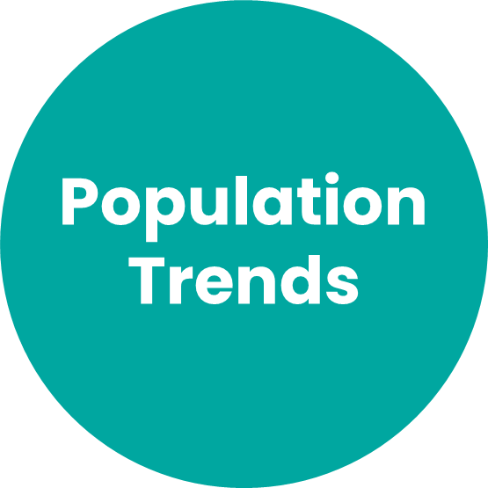
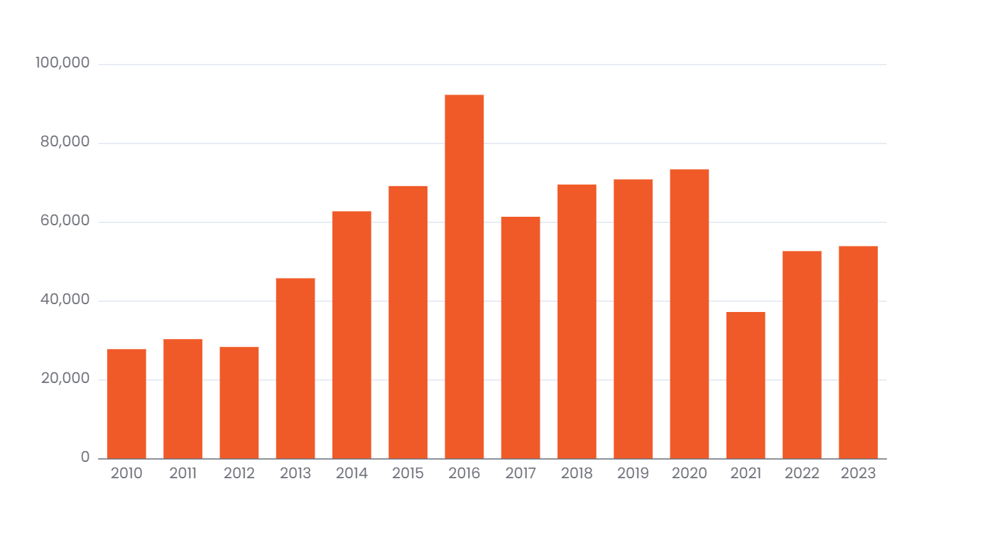
Population Growth is increasing
Annual Population Change
The region grew by almost 54,000 people between 2022 and 2023.
Source: Washington State Office of Financial Management April 1st Population Estimates
Notes:
OFM Population data is released in July each year. Last updated using data from July 2023.

Slide 3
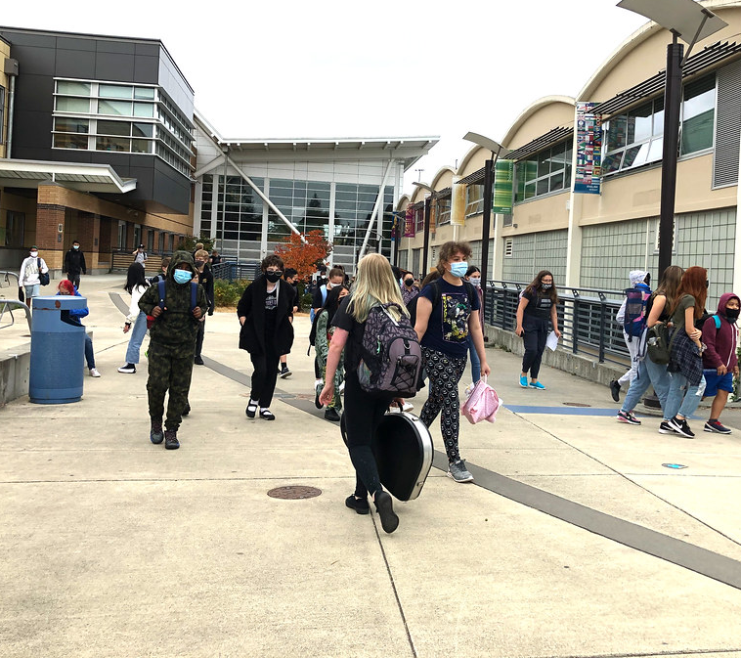
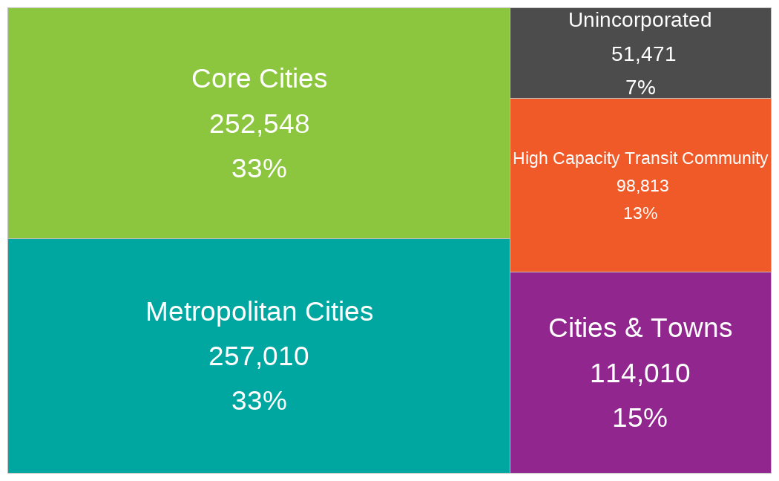
Most growth has occurred in cities
Growth by Regional Geography: 2010 to 2023
66% of population growth since 2010 has been in our largest cities
Source: Washington State Office of Financial Management April 1st Population Estimates
Notes:
OFM Population data is released in July each year. Last updated using data from July 2023.

Slide 4
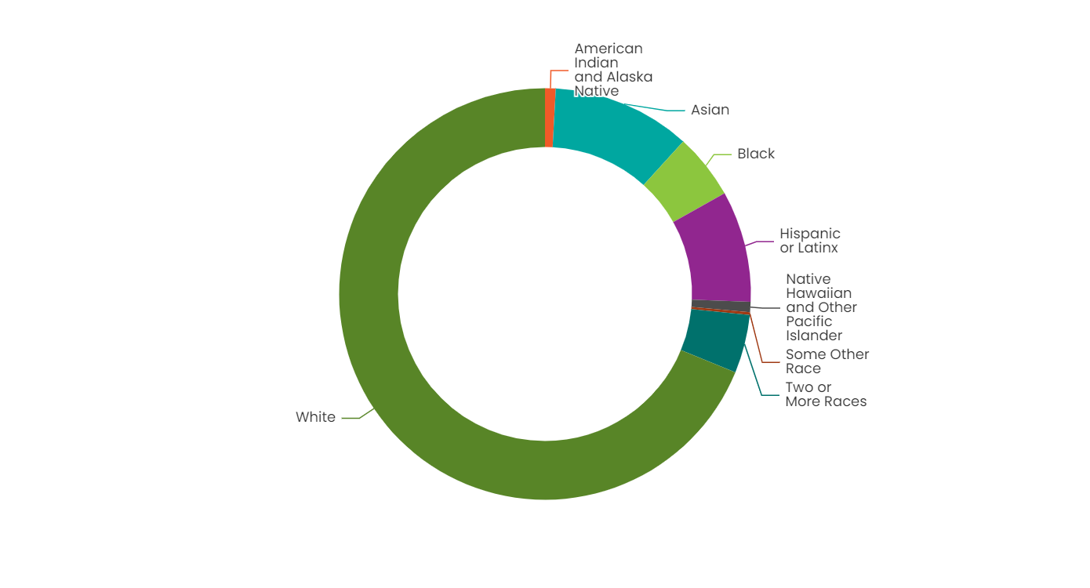
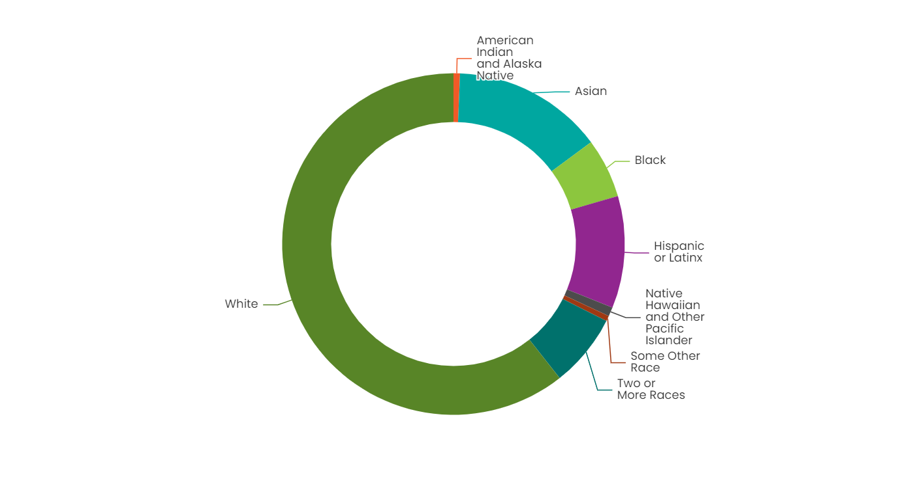
The region is growing more diverse
Population by Race: 2012
Population by Race: 2022
In 2012, white residents were 69% of the population. In 2022, that was down to 61%.
People of Hispanic or Latinx origin grew to 11% of the population in 2022.
Source: US Census Bureau American Community Survey 5yr Data Table B03002
Notes:
ACS 5-yr Census Data is released in December each year. Last updated using December 2023 data release (for the year 2022).

Slide 5
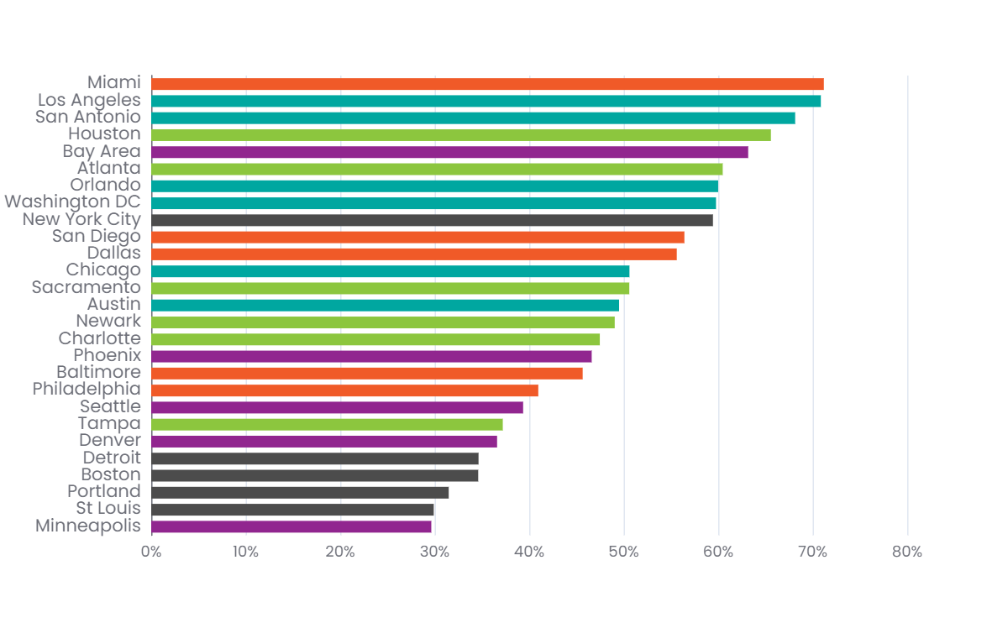
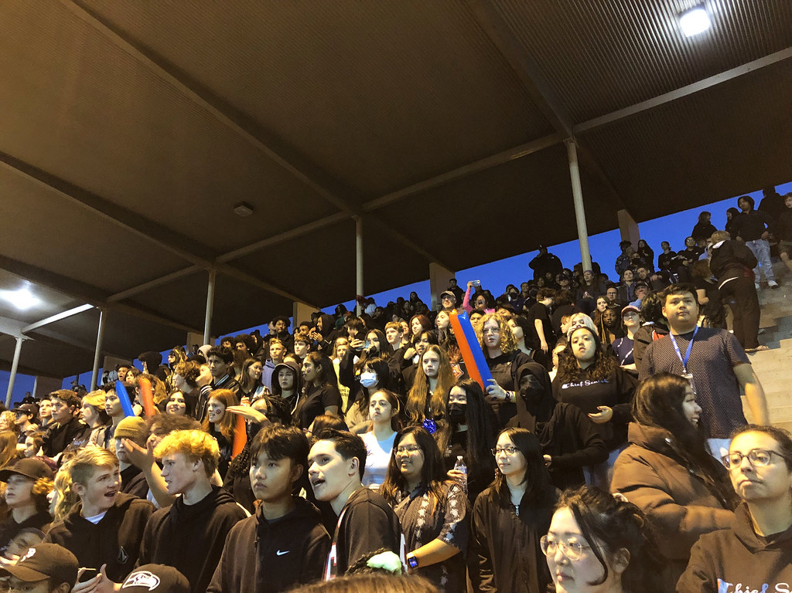
We are one of the less diverse Metropolitan Areas
Seattle ranks 19 of 27 major metropolitan regions with 39% of the population people of color.
Source: US Census Bureau American Community Survey 5yr Data Table B03002
Notes:
ACS 5-yr Census Data is released in December each year. Last updated using December 2023 data release (for the year 2022).

Slide 6
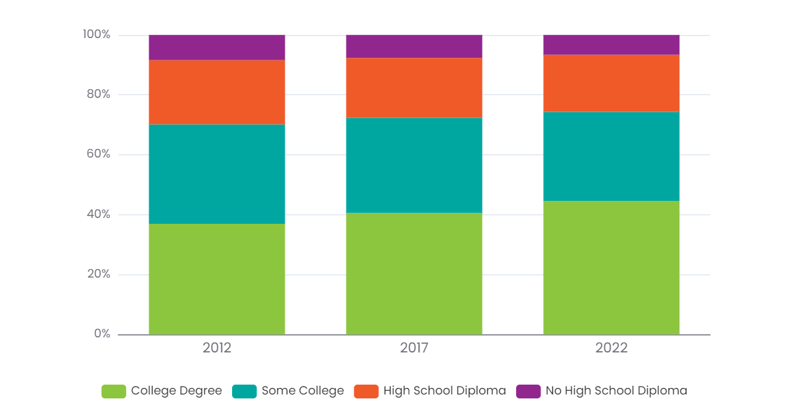
The region is growing more educated
Educational Attainment: PSRC Region
In 2012, approximately 37% of people in the region over age 25 had a college degree
In 2022, approximately 45% of people in the region over age 25 had a college degree
Source: US Census Bureau American Community Survey 5yr Data Table B15002
Notes:
ACS 5-yr Census Data is released in December each year. Last updated using December 2023 data release (for the year 2022).

Slide 7
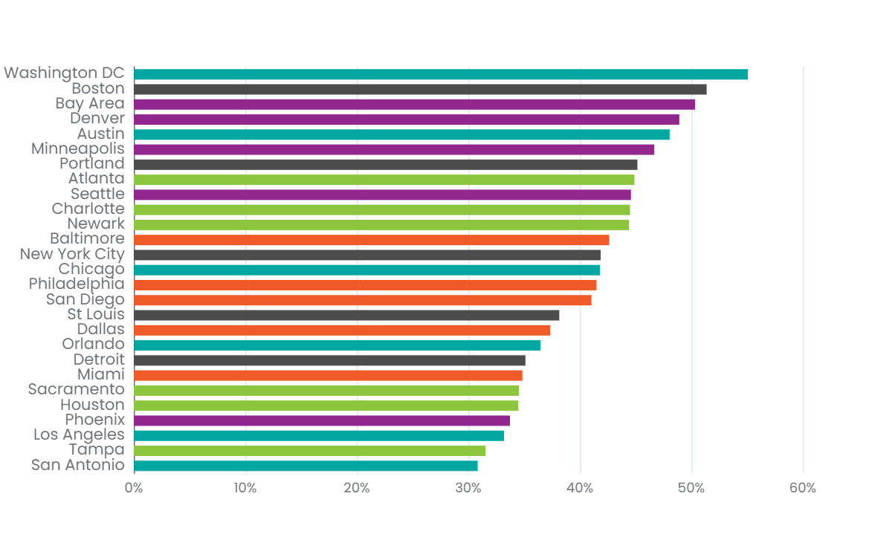
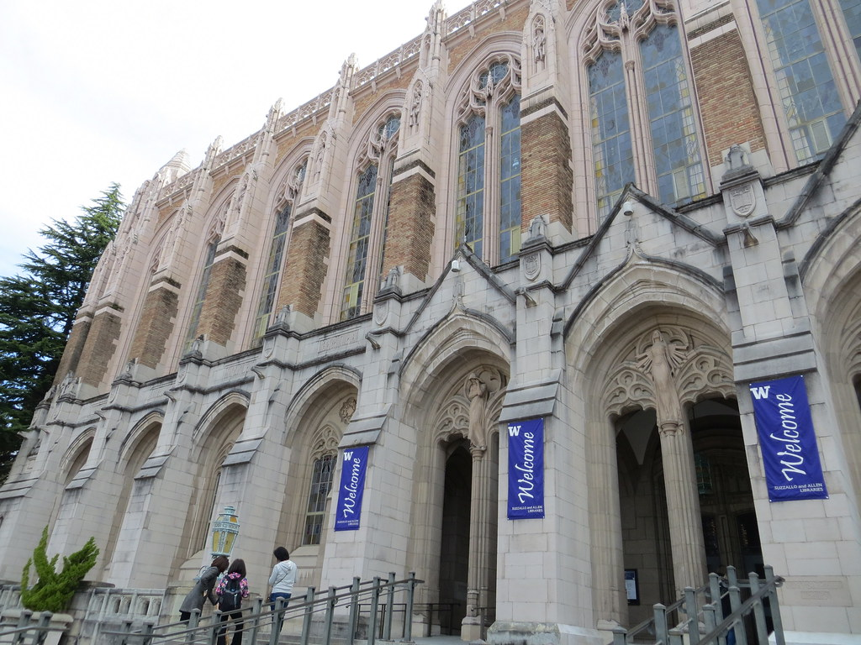
We are one of the more educated Metropolitan Areas
People with at least a Bachelor’s Degree
Seattle ranks 9 of 27 major metropolitan regions with 45% of people over age 25 with a least a Bachelor’s Degree.
Source: US Census Bureau American Community Survey 5yr Data Table B15002
Notes:
ACS 5-yr Census Data is released in December each year. Last updated using December 2023 data release (for the year 2022).

Slide 8
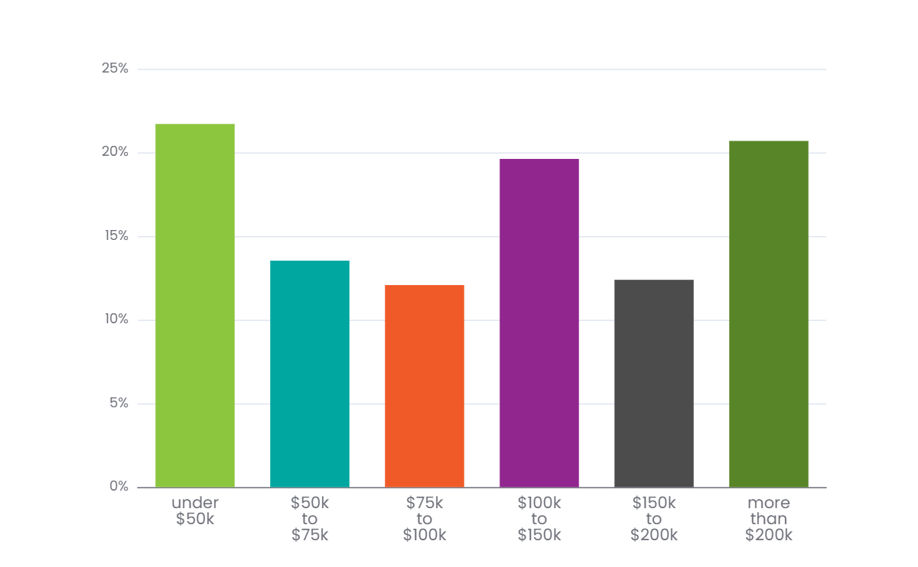
Income gaps exist
Household Income: PSRC Region
In 2022, approximately 53% of households in the region made of $100,000 per year
More households make less than $50,000 per year than make $200,000 per year.
Source: US Census Bureau American Community Survey 5yr Data Table B19001
Notes:
ACS 5-yr Census Data is released in December each year. Last updated using December 2023 data release (for the year 2022).

Slide 9
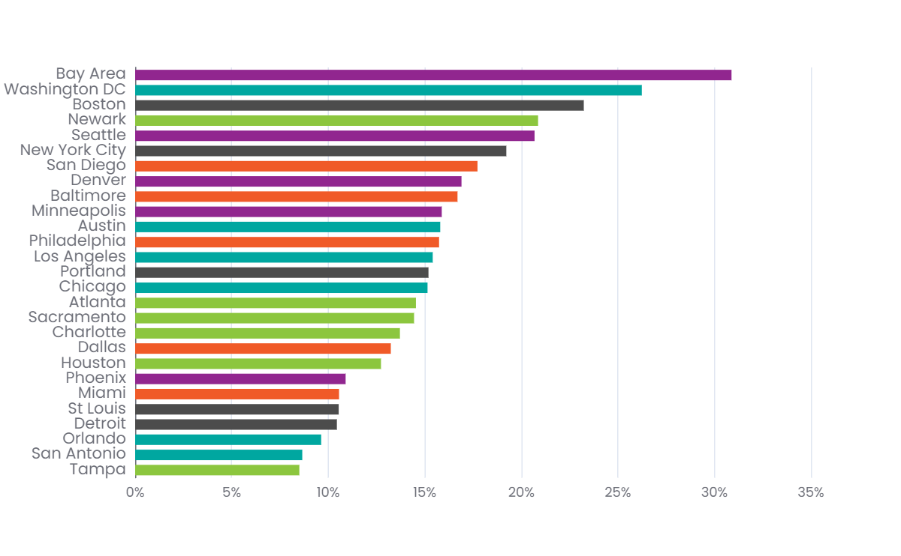
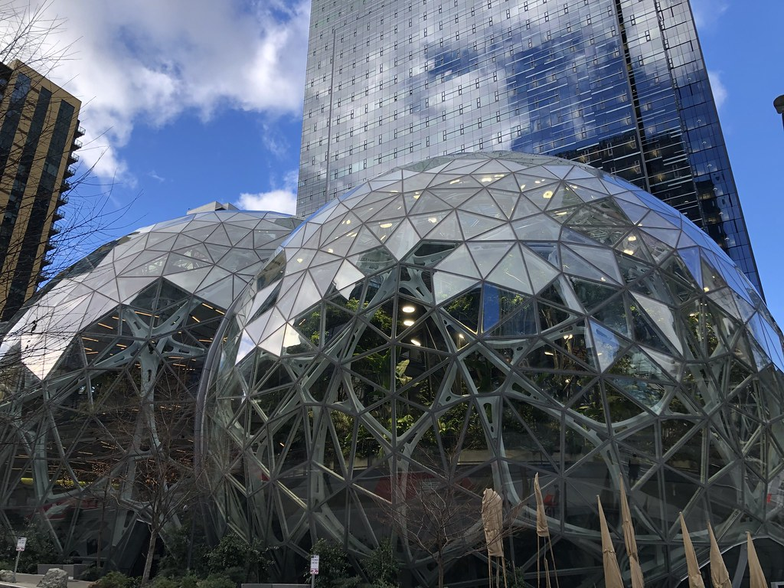
We have a high share of high-income workers
% of Households that make more than $200,000
Seattle ranks 5 of 27 major metropolitan regions with 21% of households earning more than $200,000 per year.
Source: US Census Bureau American Community Survey 5yr Data Table B19001
Notes:
ACS 5-yr Census Data is released in December each year. Last updated using December 2023 data release (for the year 2022).

Slide 10
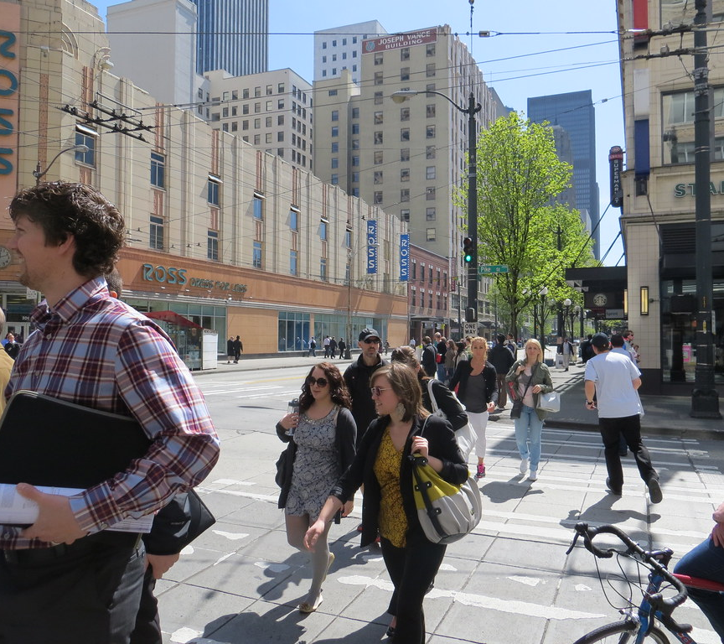
Safety Trends
Goal:
Zero Fatal and Serious Injuries by 2030

Slide 11

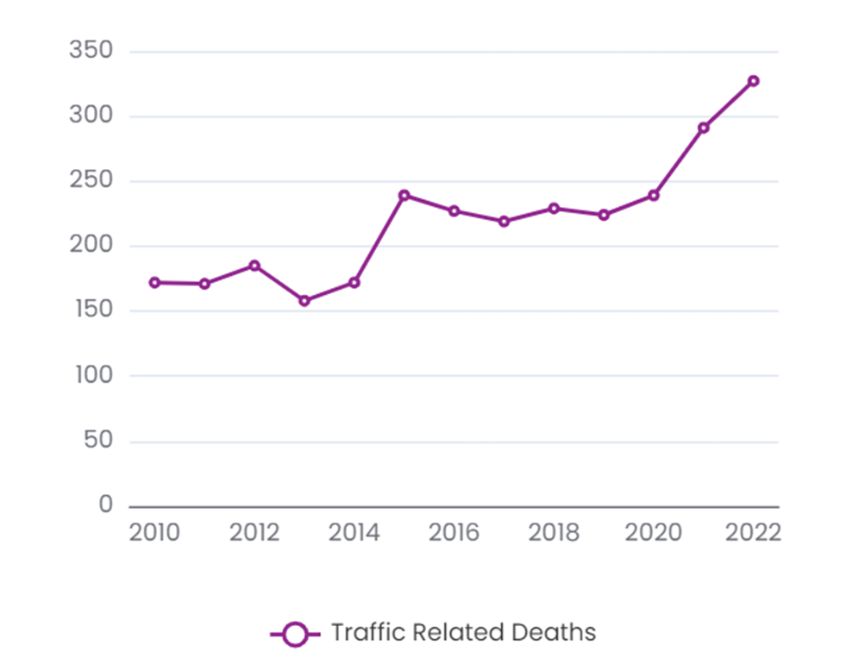
Annual Traffic Related Deaths
In FY2022, PSRC collaborated with six member governments to obtain a $4.9M Safe Streets for All (SS4A) grant to develop Safety Action Plans to help reverse this troubling trend.
Source: Washington Traffic Safety Commission Coded Fatality Files

Slide 12


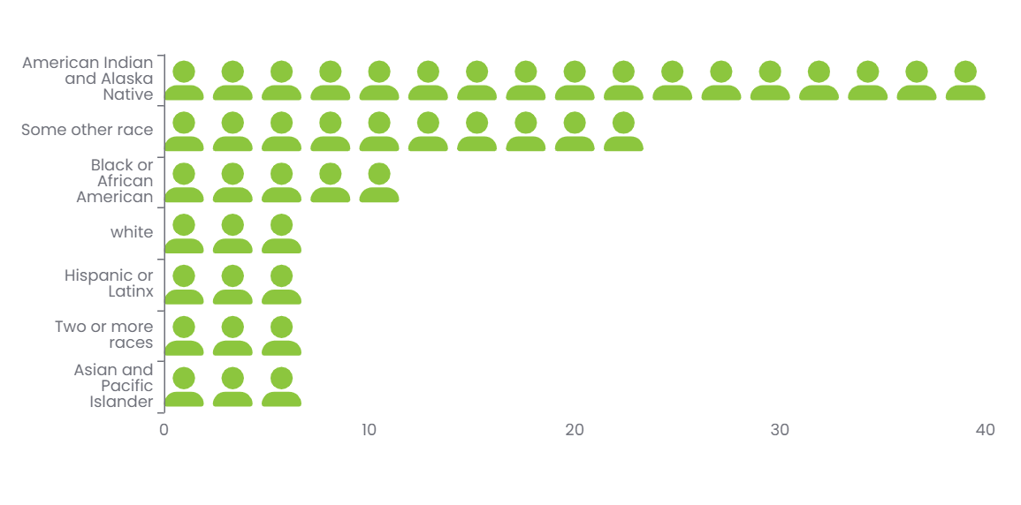
Traffic Related Deaths by Race
Traffic Related Deaths per 100,000 people: 2022
An American Indian or Alaska Native member of our community was 7 times more likely to die in a traffic collision than a white resident in 2022.
Source: Washington Traffic Safety Commission Coded Fatality Files

Slide 13
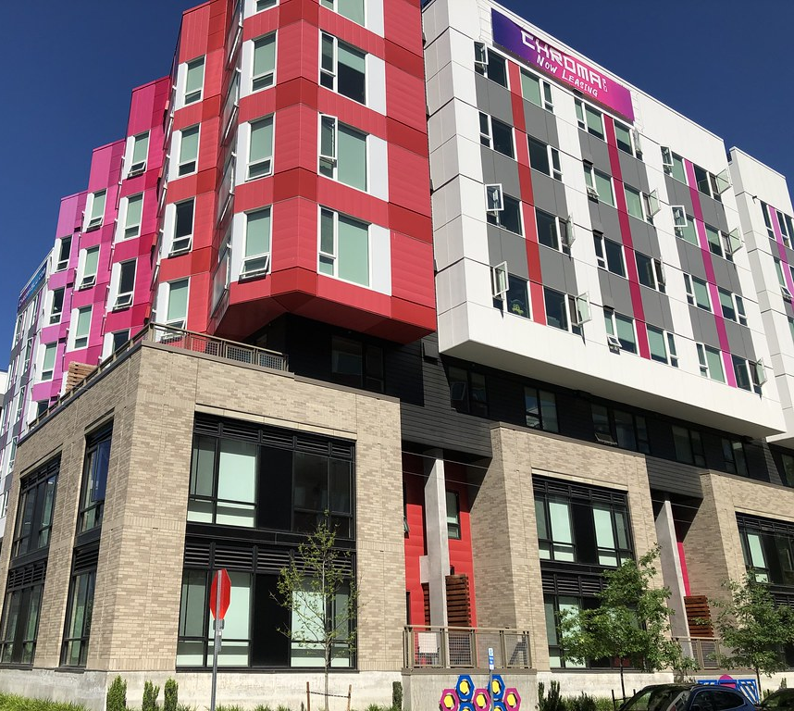
Goal:
65% Population / 75% Job Growth near High-Capacity Transit
Growth

Slide 14

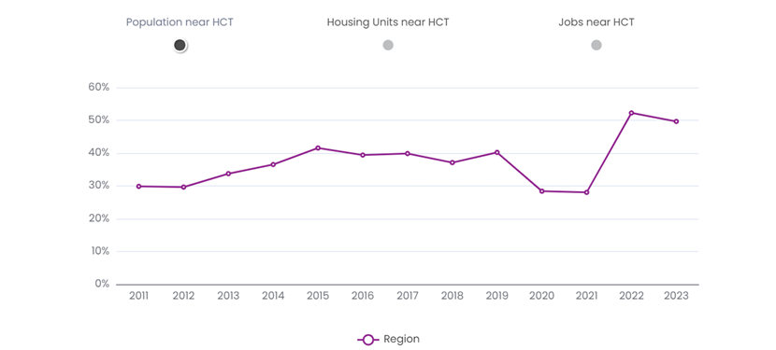
Population near HCT
Progress:
Source: Washington State Office of Financial Management Small Area Estimate Program

Slide 15
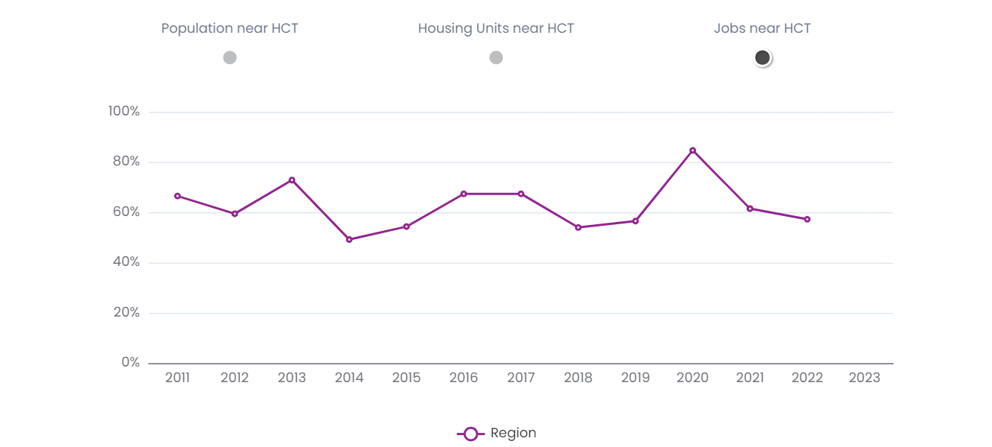
Jobs near HCT
Progress:
Source: Washington State Employment Security Department & PSRC

Slide 16
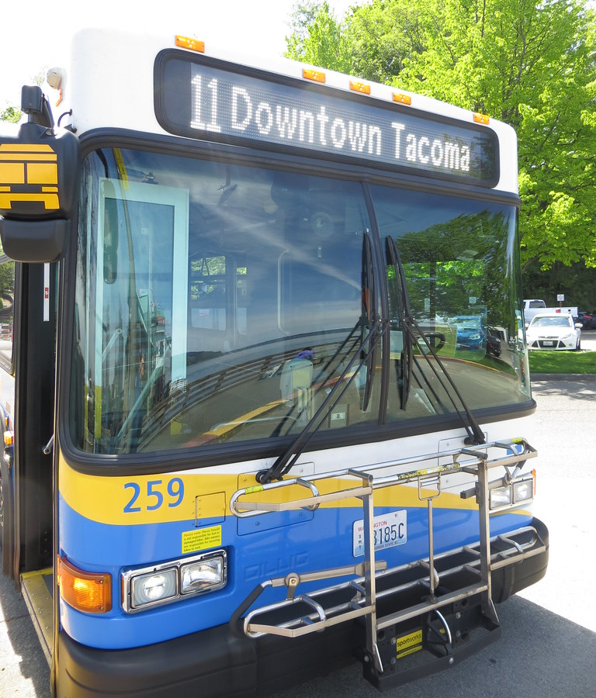
Transit, Walk & Bike
Plan Outcome:
Triple Transit Boardings by 2050

Slide 17
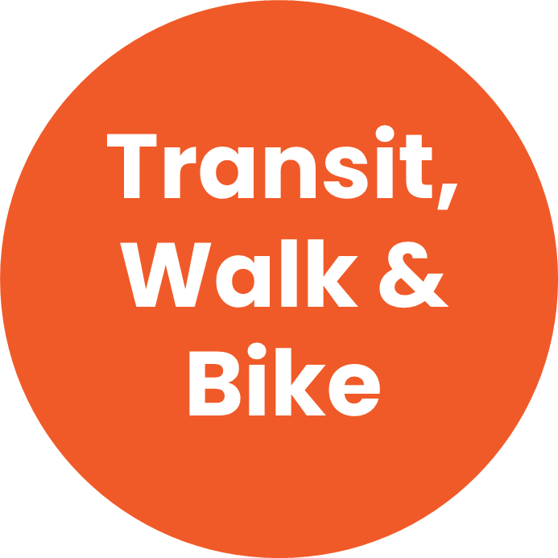

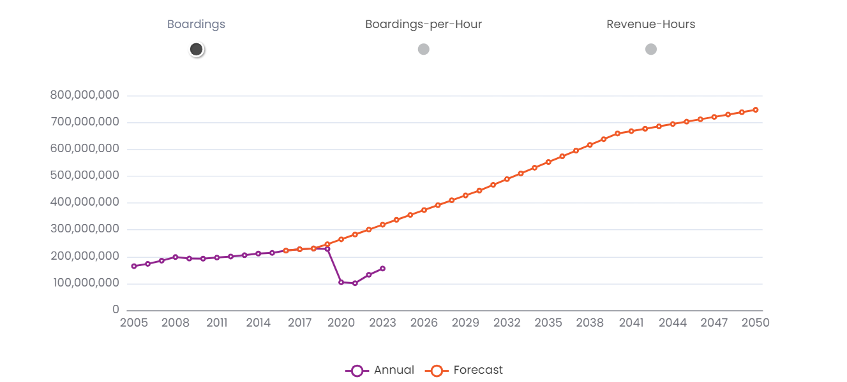
Annual Transit Boardings
Progress:
Recovery has varied by mode. Light Rail and Ferry modes are closest to pre-pandemic levels.
Commuter Rail and Vanpools, which are highly dependent on workers in major employment centers, continue to recover at slower rates.
Annual Transit Boardings
Source: USDOT Federal Transit Administration National Transit Database

Slide 18
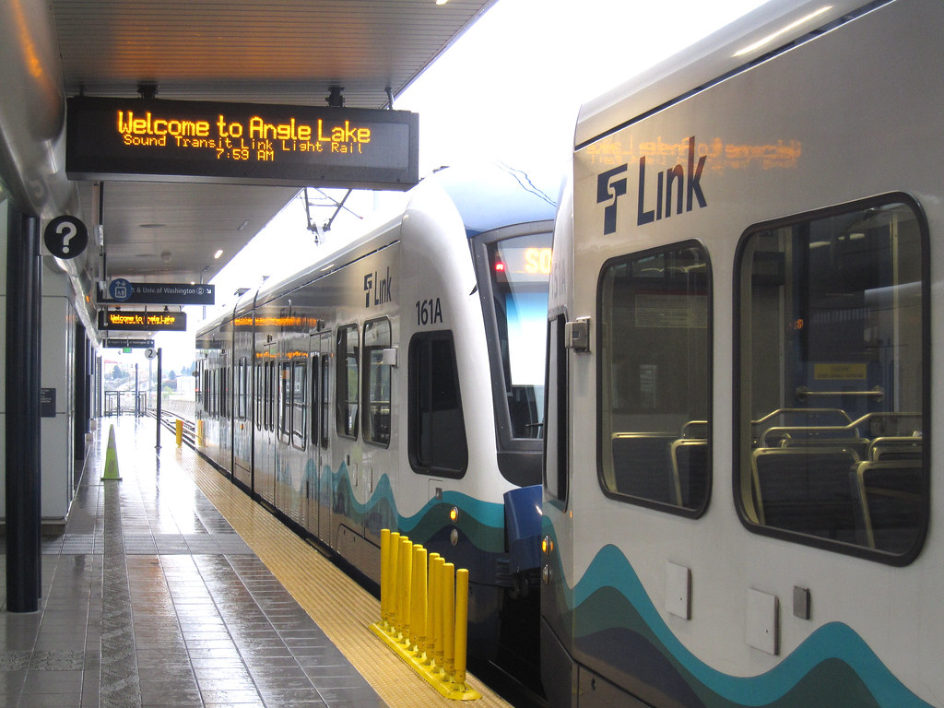
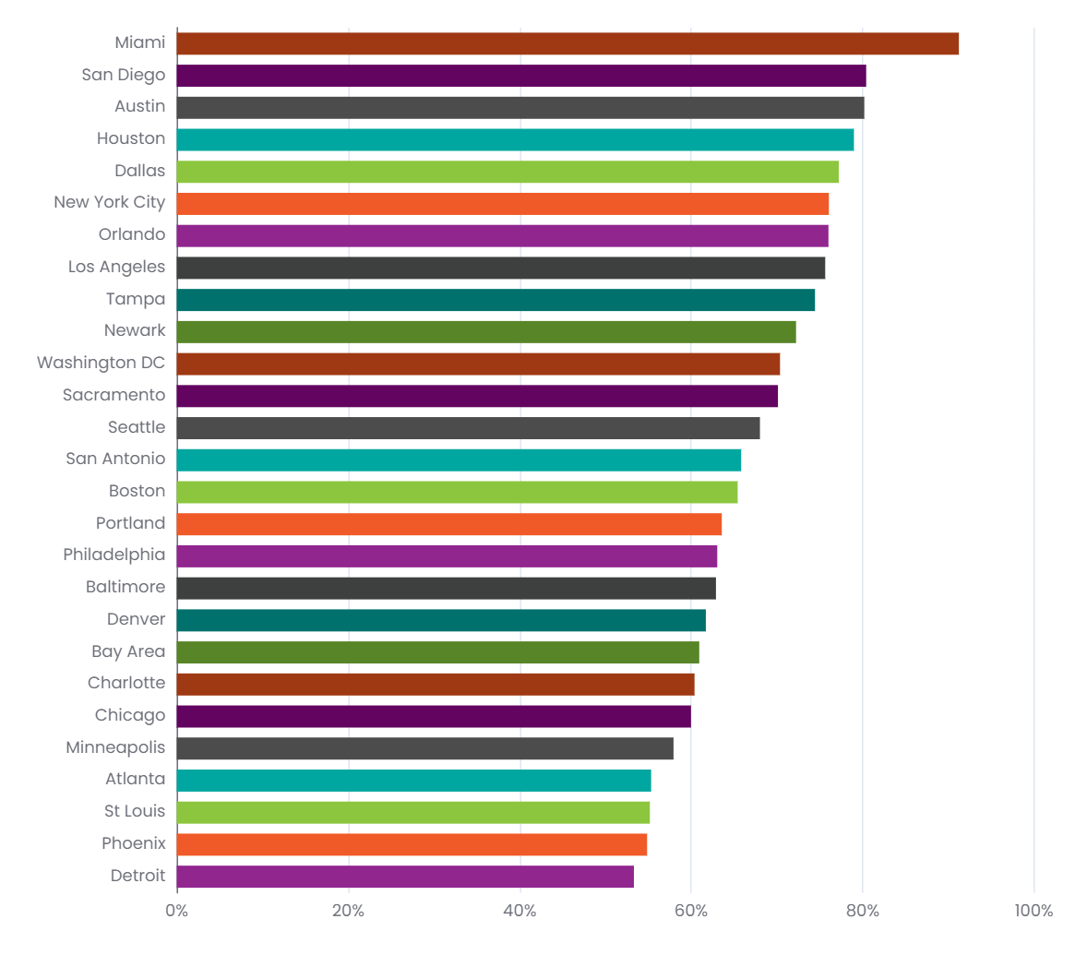
Impacts are like many Metro areas
Progress:
Ratio of Boardings to Pre-Pandemic: 2023
The PSRC Region had approximately 68% of pre-pandemic transit boardings in 2023, the 13th highest share amongst the largest metro regions in the country
Source: USDOT Federal Transit Administration National Transit Database

Slide 19

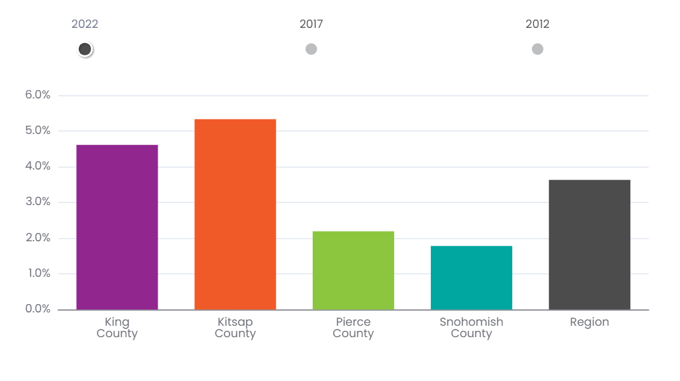
Walk to Work: 2022
Progress:
Walk to Work: 2022
PSRC Region has the 3rd Highest walk to work share for major metro areas.
Only Boston and New York City had more people walk to work in 2022.
Source: US Census Bureau American Community Survey 5yr Data Table B08301

Slide 20
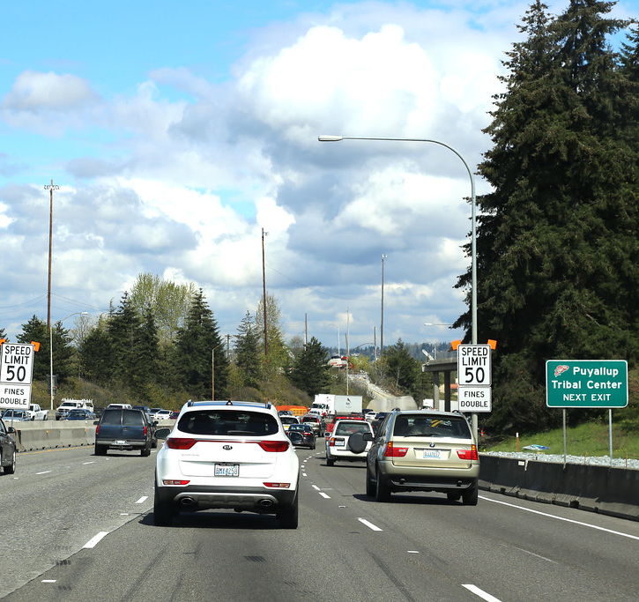
Plan Outcome:
7% reduction in Annual Delay per Household
Travel Time

Slide 21

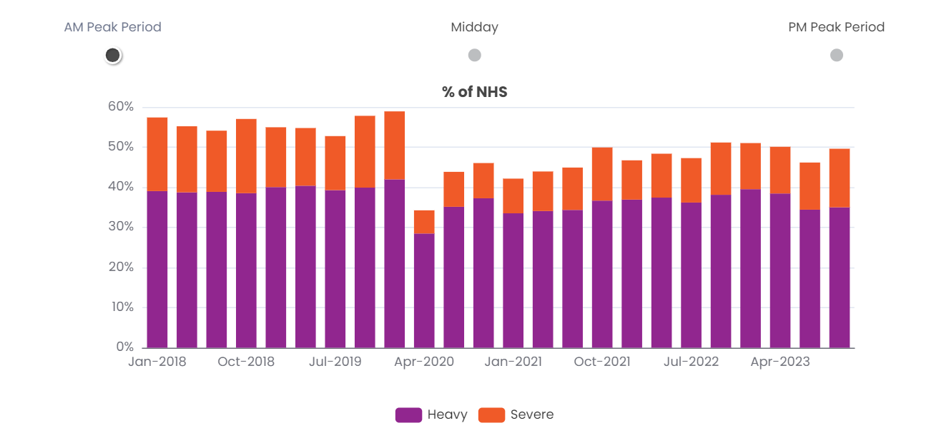
Morning Congestion
Progress:
Source: National Performance Management Research Data Set

Slide 22
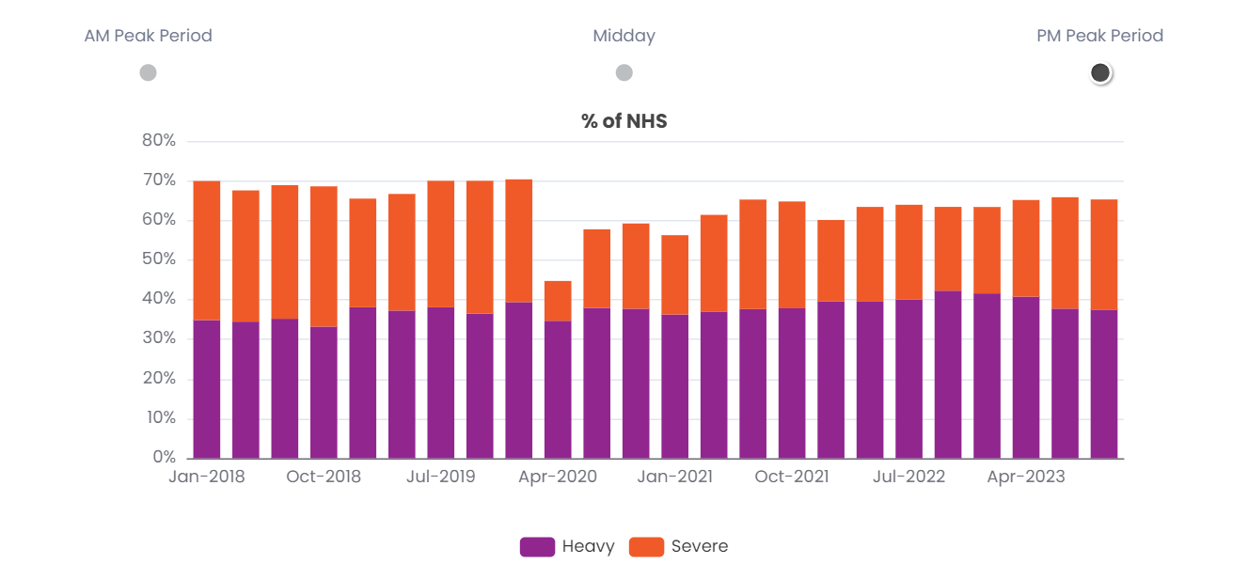
Afternoon Congestion
Progress:
Source: National Performance Management Research Data Set

Slide 23
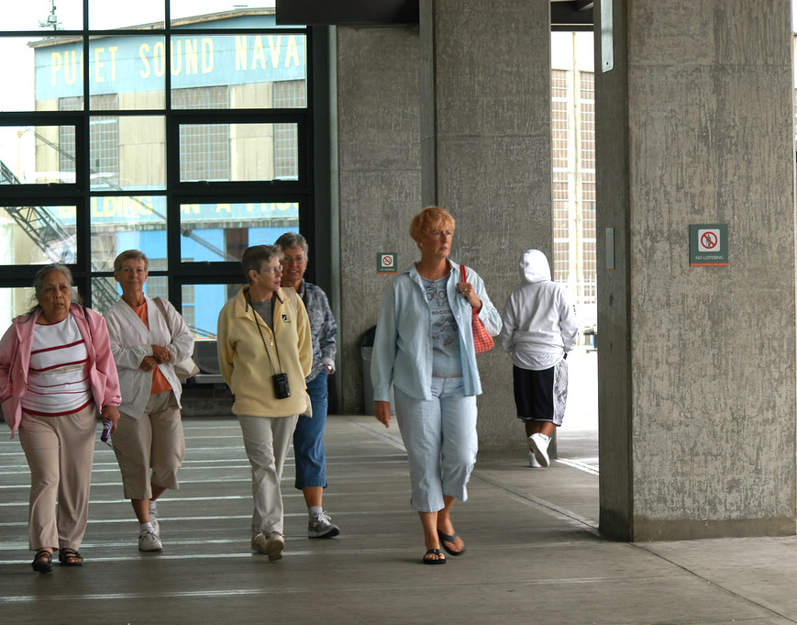
Next Steps
PSRC staff will continue to update relevant data trends and provide periodic updates.
Data on the Dashboard is updated throughout the year and the metrics are always available at:
https://psrcwa.shinyapps.io/rtp-dashboard/

Slide 24
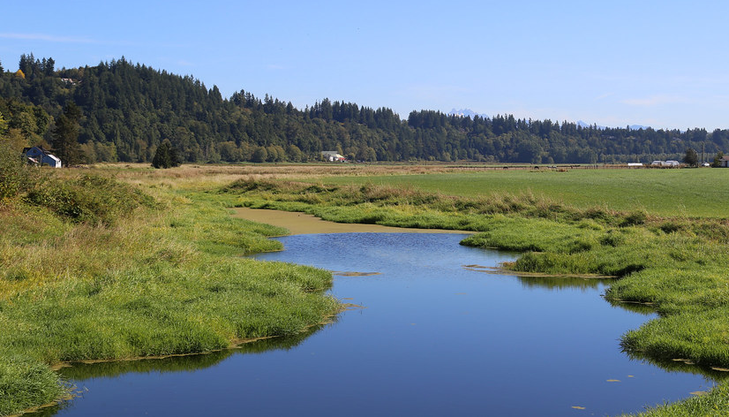

Thank you!
Craig Helmann,
Director of Data
Puget Sound Regional Council
chelmann@psrc.org
Kelly McGourty,
Director of Transportation Planning
Puget Sound Regional Council
kmcgourty@psrc.org

